Slide 1
Basic SQL
SQL Day 1 Class

Slide 2
Introduction
SQL (Structured Query Language) is a standard programming language designed for managing data held in relational databases
SQL is a declarative language - This means SQL statements specify the pattern of the results to be retrieved, rather than listing procedural steps to retrieve them
This makes SQL queries concise and efficient
It provides statements for inserting, selecting, updating and deleting data in these database

Slide 3
Introduction
Some popular SQL statements include these commands:
SELECT - retrieve data from one or more database tables.
INSERT - insert new data into a table.
UPDATE - change existing data within a table.
DELETE - delete records from a table.
CREATE - create a new table, index, view, etc.

Slide 4
Learning Objectives
By the end of this lesson, you will be able to:
Define SQL, statement, and query
Use SELECT to work with values directly
Identify common string expressions in SQL
Understand how to write math expressions in SQL
Use SELECT to query fields from a table

Slide 5
SQL Statements
SQL is written in statements - strings of characters that conform to formatting and syntax rules specified in the international standard
For example, a basic SELECT statement fetching data from a Customers table would be:
SELECT id, name, address
FROM Customers
WHERE state = 'CA’
ORDER BY name;

Slide 6
SQL Statements
Writing an SQL statement involves:
Specify the operation type:
This includes statements like SELECT, INSERT, UPDATE, DELETE. This tells the database engine what you want to do - query data, insert new data, update existing data, or delete data.
SELECT id, name, address
FROM Customers
WHERE state = 'CA’
ORDER BY name;

Slide 7
SQL Statements
Writing an SQL statement involves:
Specify the table and columns:
The statement needs to indicate from which database table and columns you want to access or operate on. Often this is done after the operation type using a FROM clause.
SELECT id, name, address
FROM Customers
WHERE state = 'CA’
ORDER BY name;

Slide 8
SQL Statements
Writing an SQL statement involves:
Specify any filtering conditions (optional):
You can filter which data rows you want using a WHERE clause and conditional logic.
SELECT id, name, address
FROM Customers
WHERE state = 'CA’
ORDER BY name;

Slide 9
SQL Statements
Writing an SQL statement involves:
Specify sorting/grouping (optional):
Statements like ORDER BY and GROUP BY can control row sorting and grouping in the output.
SELECT id, name, address
FROM Customers
WHERE state = 'CA’
ORDER BY name;

Slide 10
SQL Statements
Writing an SQL statement involves:
End with a semicolon:
All SQL statements are terminated with a semicolon ";"
SELECT id, name, address
FROM Customers
WHERE state = 'CA’
ORDER BY name;

Slide 11
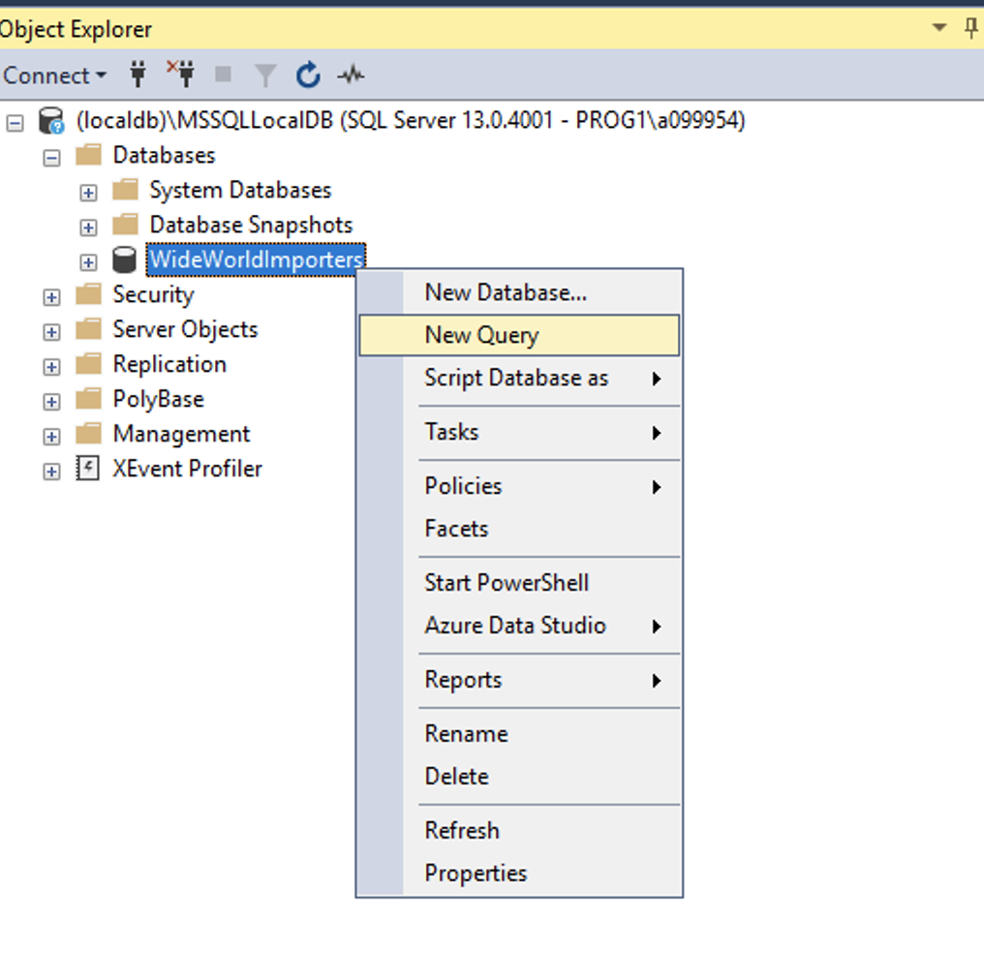
Prep
Using the World Wide Importers Database
Please open up SSMS
Connect to localhost
(localdb)\MSSQLLocalDB
Right click on WorldWideImporters
Select new query

Slide 12
Literal Strings
The SELECT command can also be used to select values such as literal strings.
When working with strings in SQL, we surround our strings with a single quote ‘ ’ on either side of the string.
Can include spaces and any characters
Give it a try in your editor:
SELECT ‘This is a String’;
The output in the results pane should show:
'This is a string' in a column with no column name.

Slide 13
Literal Strings
The SELECT keyword is used to specify which field(s) to get from a table. It can also be used to select values.
When working with strings in SQL, we surround our strings with a single quote ' on either side of the string.
Give it a try in your editor:
SELECT ‘This is a String’;
The output in the results pane should show:
'This is a string' in a column with no column name.

Slide 14
Literal Strings
Concatenating Strings
We can use the + operator to combine strings.
Give it a try in your editor:
SELECT ‘This is’ + ‘a String’;
The output in the results pane should show:
'This is a string'

Slide 15
Math
Select with Arithmetic
Arithmetic operators in SQL allow you to perform mathematical operations and calculations on numeric data types in SQL statements
Give it a try in your editor:
SELECT 1 + 1;
SELECT 3 / 2;
SELECT 3.0 / 2.0;

Slide 16
Math
The results come back as:
1 + 1 = 2
3/2 = 1
3.0/2.0 = 1.500000
The type we use makes a difference when working with numbers, as seen in the results above.
3/2 returned a whole number and no remainder.
However, if we change those inputs from integers to decimals, notice that the result changes to match the type of the operands.

Slide 17
Math
The standard arithmetic operators supported in SQL are:
Addition (+) Adds two numbers together.
Subtraction (-) Subtracts the second number from the first number.
Multiplication (*) Multiplies two numbers.
Division (/) Divides the first number by the second number
Modulus (%) Gives the remainder left over after dividing the first number by the second number.
ex: SELECT 10 % 3;
These basic mathematical operations can be used on any numeric data types like integers, decimals, floats etc.

Slide 18
Strings
Now that you have seen what SELECT does by itself, let's use it to select data from a table in a database.
Give it a try in your editor:
SELECT *
FROM Warehouse.Colors;
The query reads as:
SELECT * - select all the fields
FROM Warehouse.Colors - from the table we are concerned with

